Slide 1
Follow up predictor and reminder system
Presented by: Bridgit Kangai & Hilda Kemboi

Slide 2
Project Abstract / Executive Summary
What We Did In a Nutshell
Identified Real Problem: Through staff interviews, found a major issue with patients missing follow-up appointments.
Our Solution: Pivoted to build and deploy a machine learning model that predicts which patients are at high risk of missing their follow-ups.
The Tool: Developed an interactive dashboard for clinic staff to easily track and prioritize patient follow-ups.

Slide 3

The Problem We Solved The Challenge of Missed Follow-Ups
Why Follow-ups Matter: Essential for monitoring chronic conditions
(e.g., Diabetes, Hypertension), adjusting medication, and preventing complications.
The Old System: Manual tracking using paper registers and spreadsheets.
Consequences of the Old System:
Inefficient & Time-Consuming for staff.
Easy to Miss patients who were due for appointments.
Delayed Interventions for patients who needed care.
Poor Data Overview for planning and decision-making.

Slide 4
Project Objectives
Main Objective: To develop a machine learning model to predict a patient's risk of missing a follow-up appointment.
Specific Objectives:
Collect & Clean historical patient follow-up data.
Analyze the data to find key reasons for missed appointments.
Build & Compare different prediction models to select the best one.
Design & Deploy a user-friendly dashboard for the clinic staff

Slide 5

Methodology
[1. Data Collection]
↓
[2. Data Cleaning & Preprocessing]
↓
[3. Exploratory Data Analysis (EDA)]
↓
[4. Model Training & Evaluation]
↓
[5. Dashboard Development & Deployment]
Key Tools: Python, Pandas, Scikit-learn, Streamlit

Slide 6
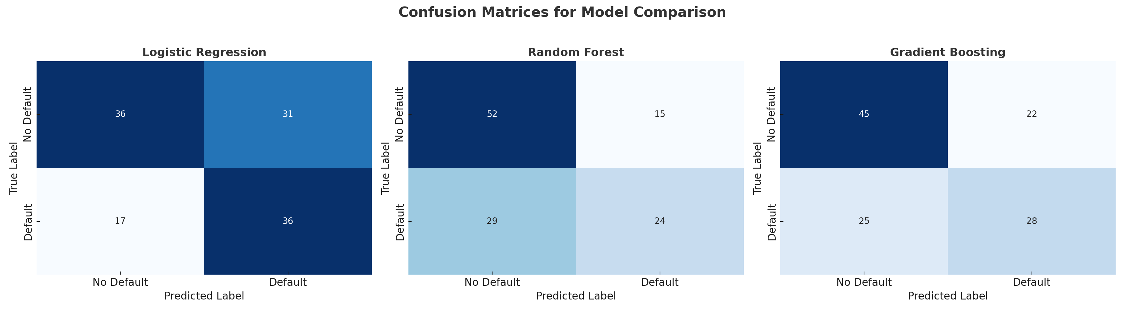
Slide 7: Data Insights & Model Selection
Key Risk Factors Identified:
No Insurance + Being Employed (time & cost constraints).
Long Follow-up Gap (more time to forget).
Specific chronic conditions.
Model Comparison:
Logistic Regression: Accuracy: 60.0% | ROC AUC: 0.659
Random Forest: Accuracy: 63.3% | ROC AUC: 0.657
Gradient Boosting: Accuracy: 60.8% | ROC AUC: 0.695
We selected Gradient Boosting because it was best at correctly
identifying patients who were truly at risk (Highest ROC AUC).

Slide 7
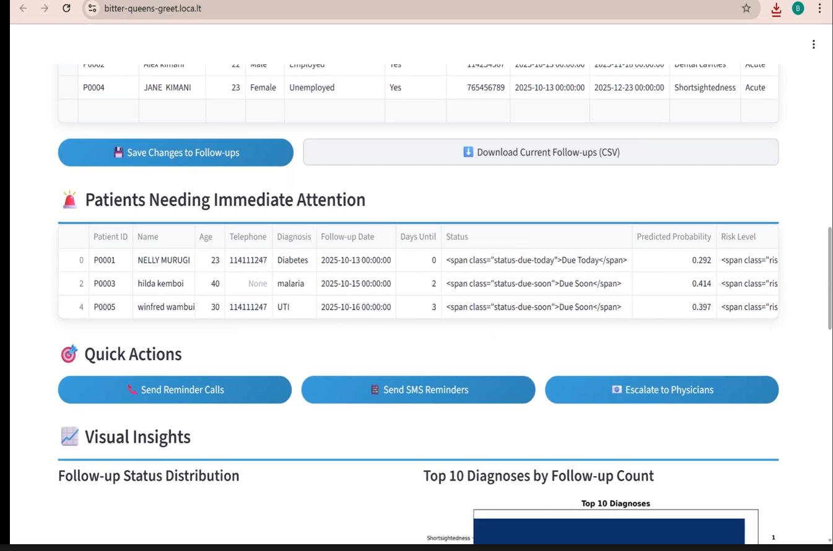
The Solution: Interactive Dashboard
Dashboard Features:
Simple Input Form: Staff enter patient details.
Instant Risk Prediction: Returns Low, Medium, or High risk category.
Visual Patient Overview: Charts showing:
Who is overdue, due today, etc.
Most common diagnoses (e.g., Hypertension, Diabetes).
Monthly follow-up schedule heatmap.
Actionable Interface: Helps staff decide who to call first.

Slide 8
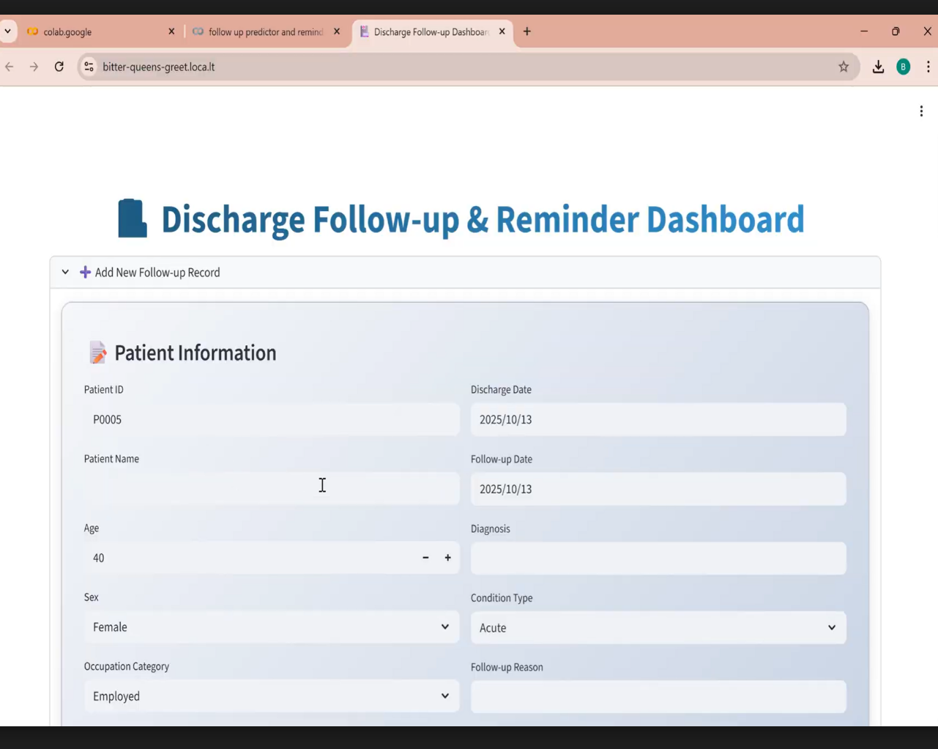
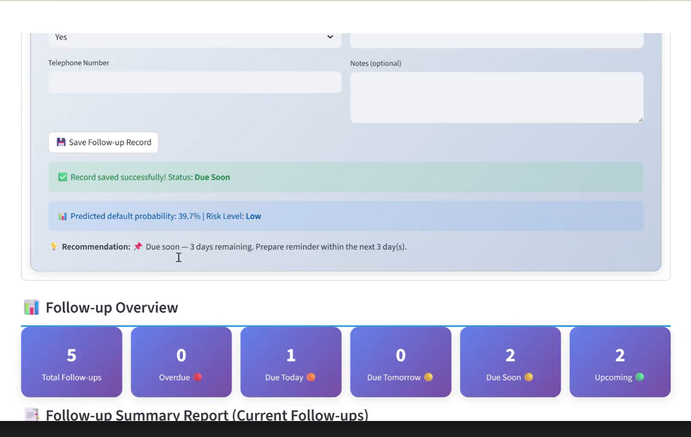
The model

Slide 9

Results & Impact
Proactive, Not Reactive: Clinic can now predict and prevent missed appointments instead of just reacting to them.
Efficiency Gain: Replaced manual spreadsheet searching with a single, visual dashboard.
Data-Driven Decisions: Staff priorities are now guided by a model's risk assessment, not just gut feeling.
Improved Patient Care: High-risk patients receive timely reminders, leading to better continuity of care and health outcomes.

Slide 10
Conclusion & Future Recommendations
Conclusion: We successfully developed and deployed a functional AI solution that tackles the critical issue of patient follow-up management making the process more efficient and proactive.
Recommendations:
Maintain the Model: Periodically retrain the model with new data to keep it accurate.
Scale the Solution: Expand this system to other health facilities.
Enhance with SMS: Integrate the dashboard with an SMS service to send automated reminders to high-risk patients.

Slide 11

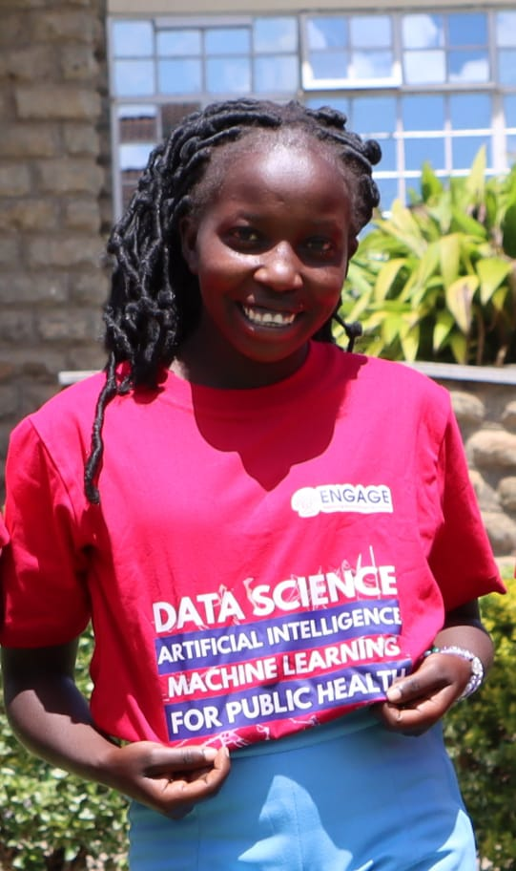
MEET THE TEAM
BRIDGIT KANGAI(FOUNDER)
PUBLIC HEALTH SPECIALIST
HILDA KEMBOI(CO-FOUNDER)
SOFTWARE ENGINEER

Slide 12
Thank You

